Slide 1
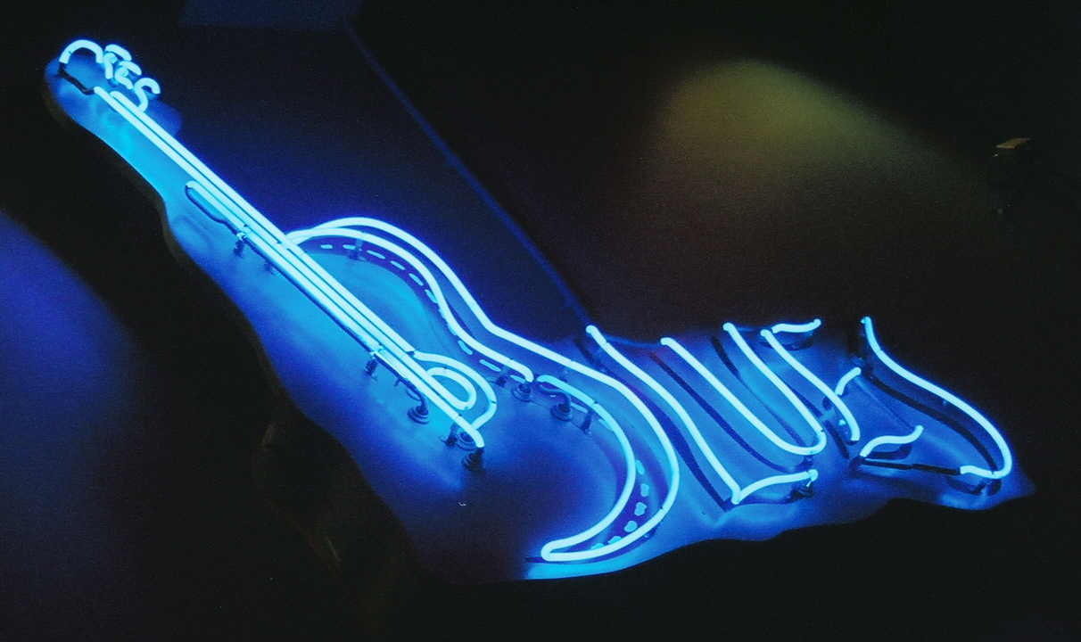
Blues and “The Treasure of Lemon Brown”
What are the
?

Slide 2
What are the Blues?
The Blues is a musical genre that originated in African-American communities of primarily the "Deep South" of the United States at the end of the 19th century from spirituals, work songs, field hollers, and shouts and chants.

Slide 3
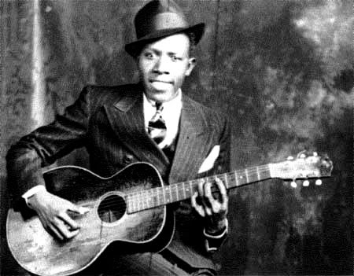
More on the Blue’s origin
The term "the blues" refers to the "blue devils", meaning melancholy and sadness.

Slide 4
The origin of the Blues
The first true blues was performed by singers who would engage in call-and-response with a guitar – the performer would sing a line, and the guitar, often played with a bottleneck or knife sliding up and down the strings, giving the instrument an eerie, voice-like moan, would answer.

Slide 5
Original Deep South Blues: “Mississippi Fred”
Mississippi Fred, Deep South Blues (right click then “open hyperlink)
Fred McDowell was born in Mississippi . His parents, who were farmers, died when McDowell was a youth. He started playing guitar at the age of 14.
Wanting a change from plowing fields, he moved to Memphis in 1926 where he worked to process cotton into oil and other products. He also played music for tips. Later in 1928 he moved to Mississippi to pick cotton where he worked steadily as a farmer, continuing to perform music at dances and picnics in the early 1940’s.
Music technique:
At first, he played slide guitar using a pocket knife and then a slide made from a beef rib bone, later switching to a glass slide for its clearer sound. He played with the slide on his ring finger.

Slide 6
Meaning of “the Blues”
Sometimes the Blues can mean “depressing.”
BUT . . . Some say that the development of the blues is associated with the newly acquired freedom of the enslaved people.
The Blues can celebrate good times!

Slide 7
“The Treasure of Lemon Brown”
Who is Lemon Brown? (right click then “open hyperlink”)
"Every man got a treasure. You don't know that, you must be a fool!"
- Lemon Brown

Slide 8
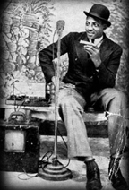
Special Note: The story of Lemon Brown is fiction.

Slide 9
What is Character Motivation? Denotation of MOTIVATION: the reason or reasons one has for acting or behaving in a particular way. Click the link to listen to Rod Sterling (Twilight Zone) discuss what character motivation means to him. Rod Sterling Video

Slide 10
1. What motivated Jane to get to know Penn? 2. What motivated Crash to lie about having a great-great-grandfather? 3. Who motivated Abby to become a vegetarian?

Slide 11
There are many examples of INDIRECT CHARACTERIZATION in “The Treasure of Lemon Brown”. In order to find them, we need to look into what it is. Denotation of INDIRECT CHARACTERIZAION: the process by which the personality of a fictitious character is revealed through the character's speech, actions, appearance, etc. Watch the video and take notes. Indirect Characterization

Slide 12
Crash is a bully. How does Jerry Spinelli use indirect characterization to show this? SPEECH THINKS EFFECT ON OTHERS ACTIONS LOOKS

