Slide 1
Unit 5 Terms
Persuasive Tactics

Slide 2
Bandwagon
A party, cause, movement, which has mass appeal or strength.
Attracts many followers
Example: sports teams
Example: camera ad on next slide

Slide 4
Bias
A tendency which prevents unprejudiced consideration of a question; prejudice
Ex: During an athletic event, the referee should not have any bias.
Ex: “What a cute baby!”

Slide 5
Propaganda
information, rumors, ideas , and artwork spread deliberately to help or harm another specific group, movement, belief, institution, or government.
Example on next slide

Slide 6
ENOUGH with Kitchen Slavery! Soviet Propaganda Poster

Slide 7
Rhetoric
The art of persuasive argument through writing or speech.

Slide 8
Semantic Slanting
When an author uses specific word choice to evoke a certain emotion.
Example on next slide

Slide 9
Card Stacking (Semantic Slanting)
Advertisers change the way they say something to make it sound more positive. They may twist their language so that their message is said in a way that puts them in a better light.
On this cereal box, Frosted Flakes claims to be a good source of vitamin D, but if you read the label, you might be surprised.

Slide 10
Notice the cereal alone only contains 10% of your daily value of vitamin D.
Do you consider Frosted Flakes to be a good source if you are only receiving 10% of your daily intake?
If you add ½ cup of vitamin D milk, it raises the value to 25%. What is the “REAL” good source of vitamin D?

Slide 11
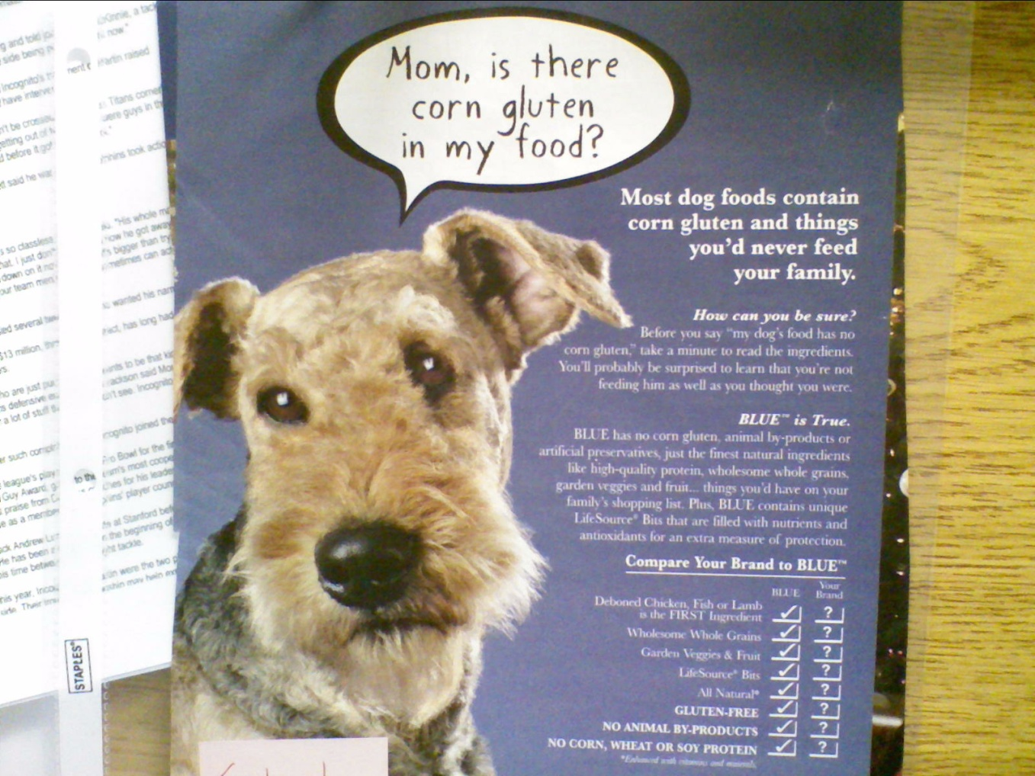
Emotional Factors
When the author plays on emotions

