Slide 1
Ribbons
By Laurence Yep

Slide 2
Pre-Reading Writing Prompts
Agree or Disagree
In 2-3 sentences, explain your stance using evidence from your personal experience.
“People cannot hurt each other if they try to be kind."
"The smaller the differences between people, the greater the chances for misunderstanding."
"Everyone has something valuable to teach."

Slide 3
VOCABULARY BUILDER Write a sentence WITH CONTEXT CLUES for each word Sensitive p.1 Coax p. 2 Laborious p. 2 Exertion p. 2 callused p. 3 furrowed p. 4 solemnly p. 5 What TO DO: He extricated himself from the trap and ran to safety. (Can you find the context clues?) What NOT to do: He extricated himself. (Where are the context clues?)

Slide 4
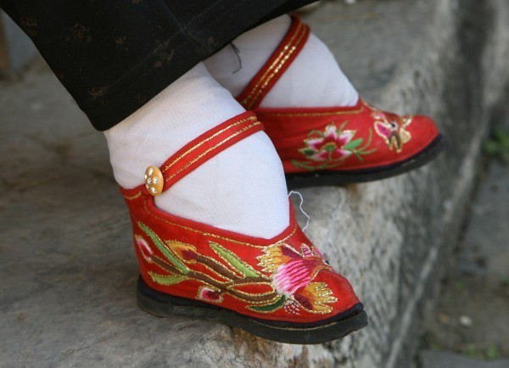
Chinese Foot Binding
Foot binding (also known as "Lotus feet") is the custom of applying painfully tight binding to the feet of young girls to prevent further growth. The practice possibly originated among upper-class court dancers during the Five Dynasties and Ten Kingdoms period in Imperial China (10th or 11th century), but spread in the Song Dynasty and eventually became common among all but the lowest of classes. Foot binding became popular as a means of displaying status (women from wealthy families who did not need them to work could afford to have their feet bound) and was correspondingly adopted as a symbol of beauty in Chinese culture.

Slide 5
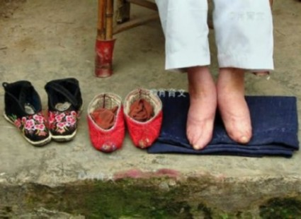
watch a video about Chinese foot binding.

Slide 6
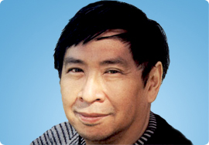
Laurence Yep Laurence Michael Yep (born June 14, 1948) is a prolific Chinese-American writer, best known for children's books. In 2005, he received the biennial Laura Ingalls Wilder Medal for his career contribution to American children's literature. watch a video about the author

Slide 7
Why? What are some reasons for reading “Ribbons” by Laurence Yep?

Slide 8
Assignment
Begin reading “Ribbons” by Laurence Yep. Complete the study guide on Google Classroom as you read. Yes, you may mark on/annotate the short story!

