Slide 1
Suzy and Leah p. 112 #1-8

Slide 2
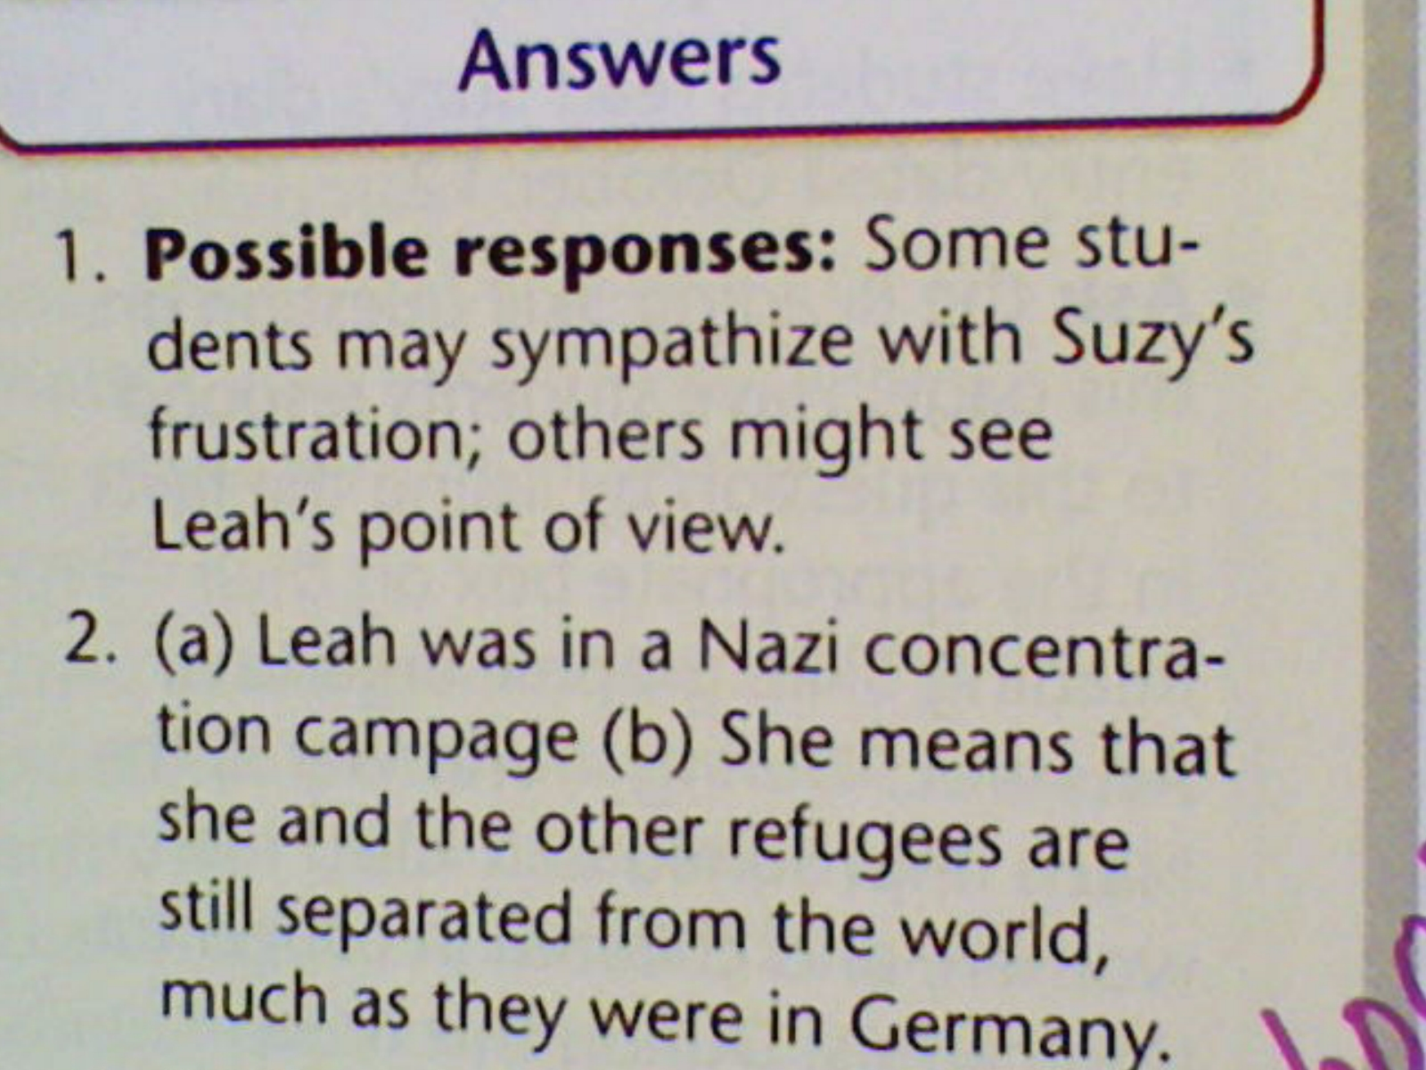

Slide 3
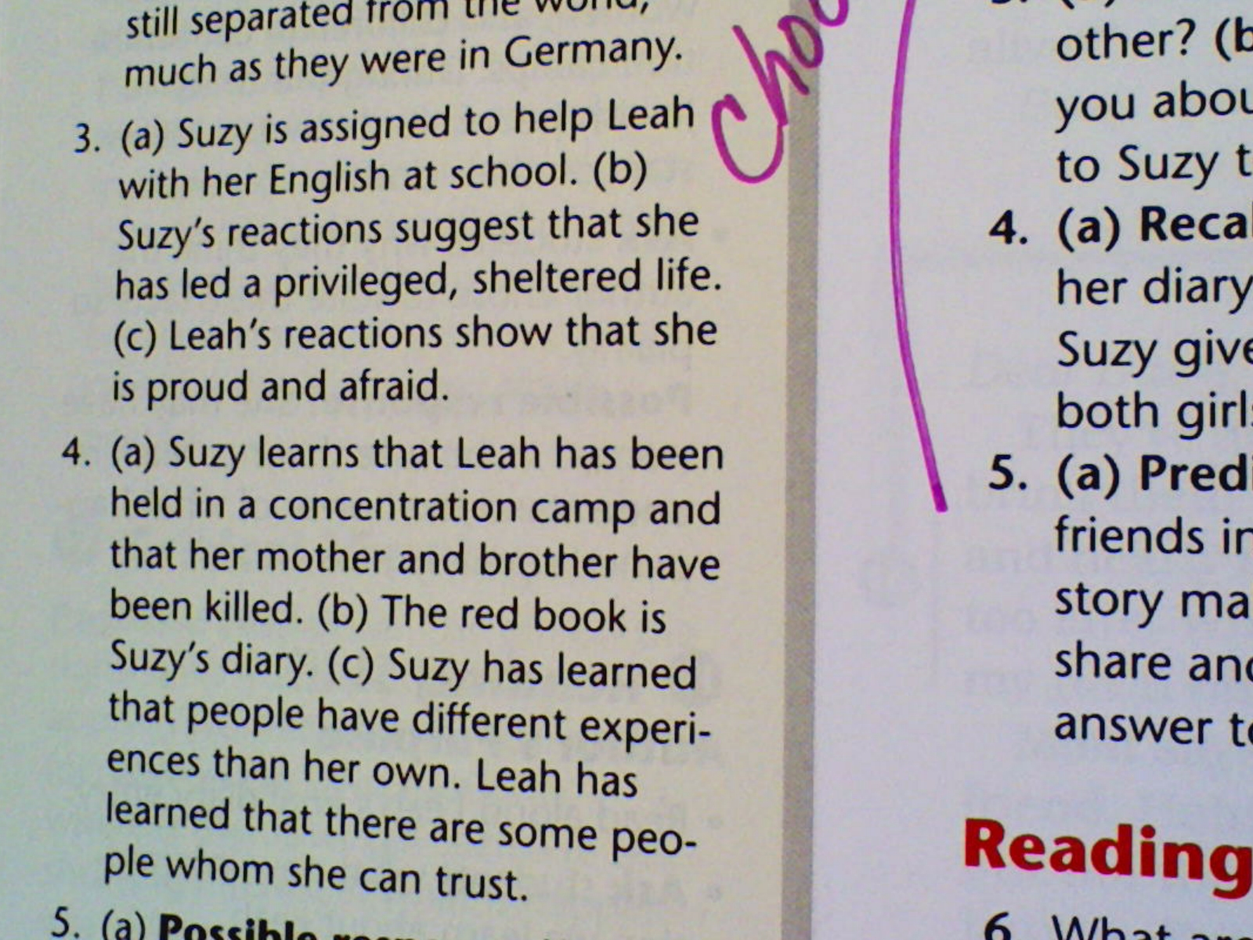

Slide 4
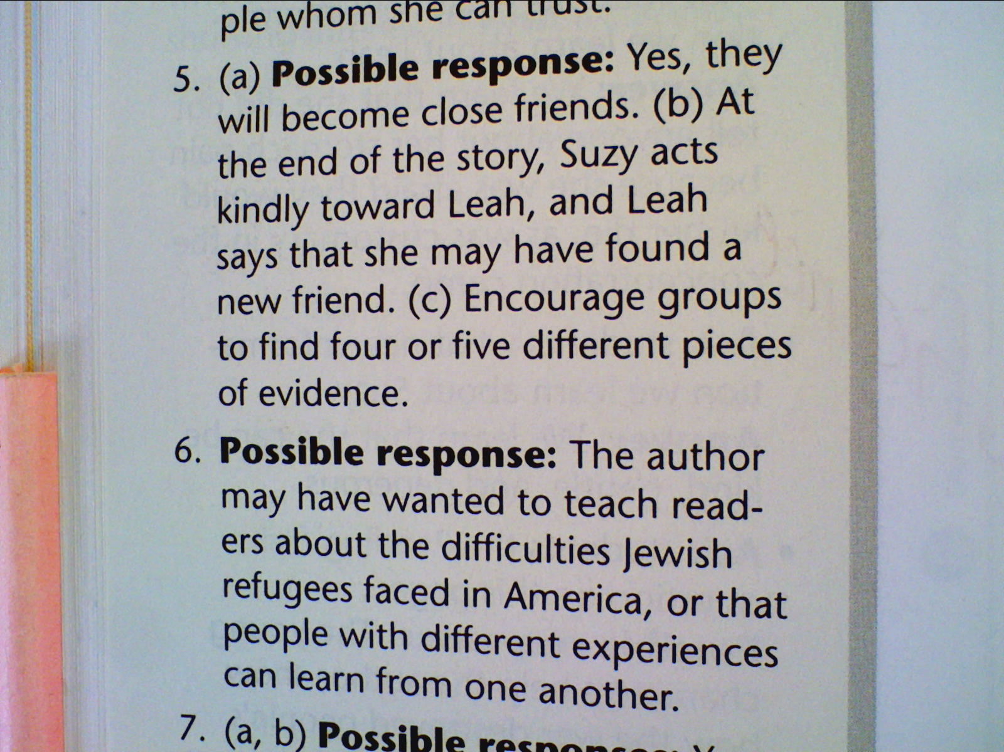

Slide 5
