Slide 1
With the growth of the Internet, the flow of persuasive messages has been dramatically accelerated. For the first time ever, citizens around the world are participating in uncensored conversations about their future. This is a wonderful development, but there is a cost
The information revolution has led to information overload, and people are confronted with hundreds of messages each day. Many people respond to this pressure by processing messages more quickly and, when possible, by taking mental short-cuts.

Slide 2
Propagandists love short-cuts. They encourage this by agitating emotions, by exploiting insecurities, by capitalizing on the ambiguity of language, and by bending the rules of logic. As history shows, they can be quite successful. Propaganda analysis exposes the tricks that propagandists use and suggests ways of resisting the short-cuts they promote by giving strategies of mental self-defense.

Slide 3
War Propaganda
The Nazis prepared for war from the moment Hitler came into power in 1933. In the feverish building up of German striking power, they had the support of the professional military men. The Nazis not only produced the weapons of war; they geared their economy for the strain of a future conflict. They carried on political intrigues to promote their purposes. Their propaganda machine had long been a going concern when Hitler felt ready to strike at Poland, the first step in an ambitious plan to lay the world at his feet.
To understand how this four-dimensional warfare has come about, we have to look at history.

Slide 4
Look at each poster from World War II. Be ready to discuss the propaganda used in each. bias semantic slanting emotional factors

Slide 5
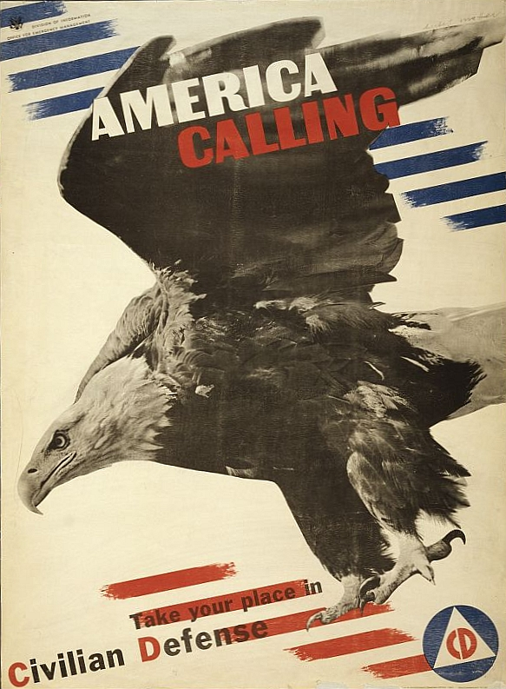
semantic slanting
emotional factors
bias

Slide 6
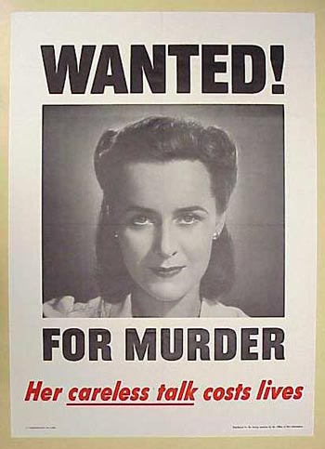

Slide 7
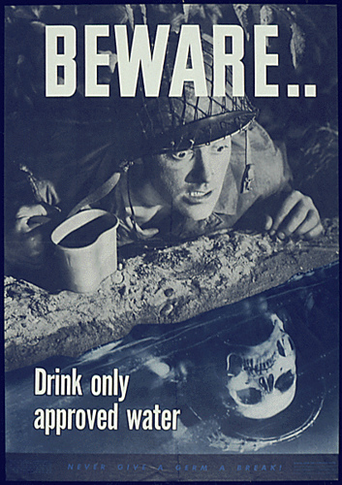

Slide 8
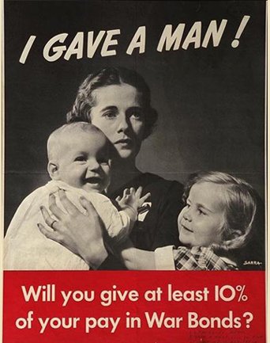

Slide 9
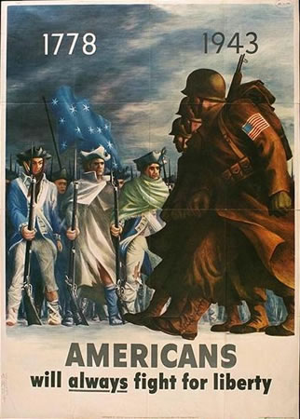

Slide 10
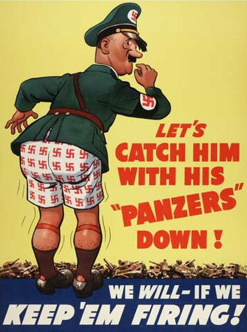

Slide 11
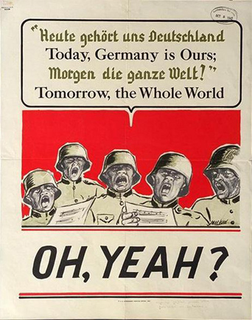

Slide 12
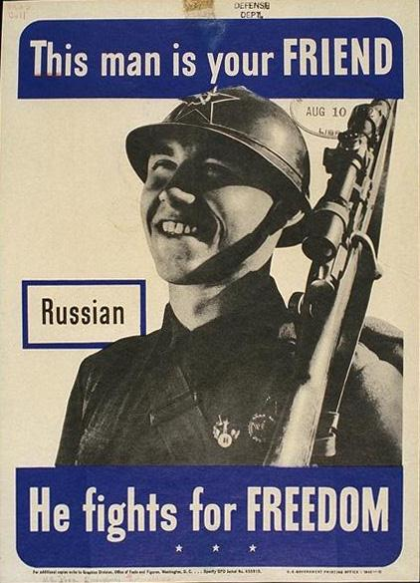

Slide 13
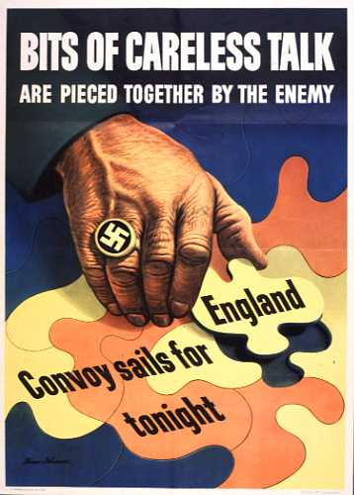

Slide 14
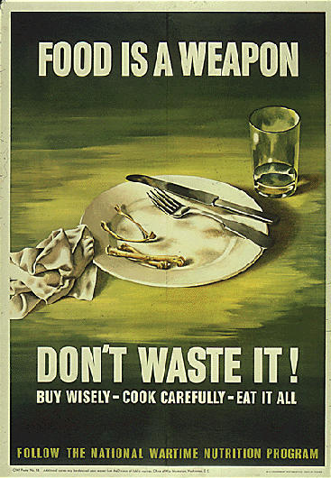

Slide 15
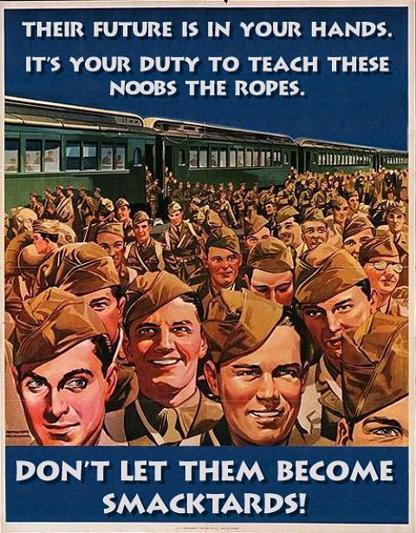

Slide 16
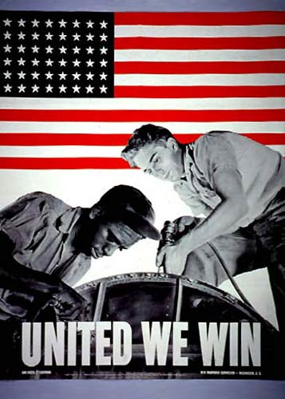

Slide 17
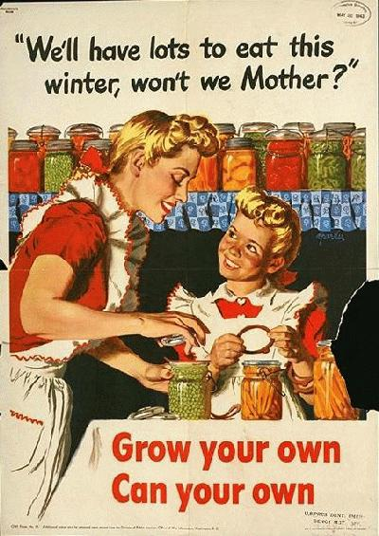

Slide 18
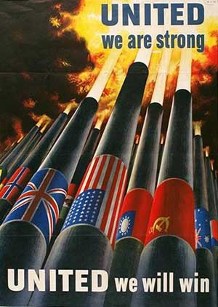

Slide 19
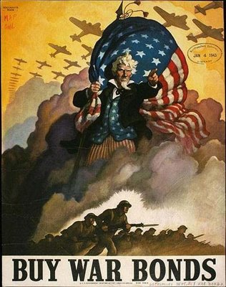

Slide 20
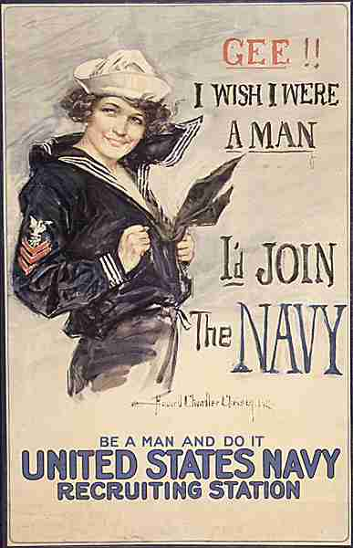

Slide 21
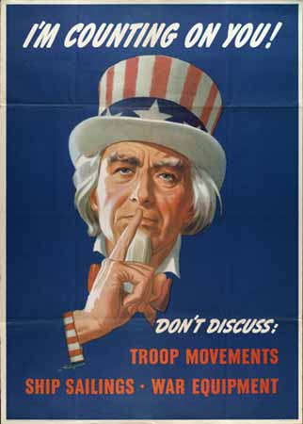

Slide 22
